Slide 1

Applied AI for Botnet Detection
Professor Mimoza Dumodugno
EAI 6980 –Integrated Experiental Capstone
College of Professional Studies, Northeastern University
By: Nilay Anand and Trieu Vo

Slide 2
Table of Contents
Introduction
Problem Statement
Dataset
Related Work
Methodology
Model Building and Evaluation
Conclusion and Future Work

Slide 3
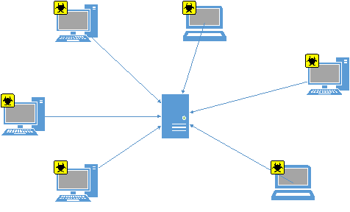
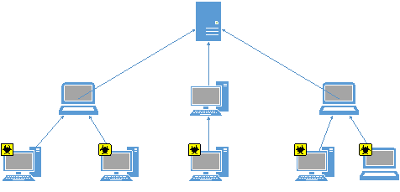
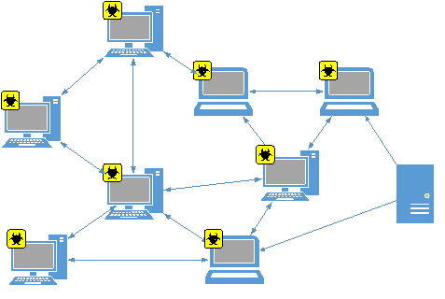
Introduction
A botnet is a set of computers infected by bots. A bot is a piece of malicious software that gets orders from a master.
Bots can then read and write files, execute programs, intercept keystrokes, access the camera, send emails, etc.
Botnet masters rent their botnets to other criminals for various purposes:
Send spam
Perform DDoS attacks
Steal banking information
Host illegal files
FBI estimates botnets have caused
$9 billion in losses to U.S. victims
$110 billion in losses globally
Approximately 500 million computers infection each year which translates to 18 victims per second.
Central C&C Server
Proxied C&C
Peer-to-peer

Slide 4
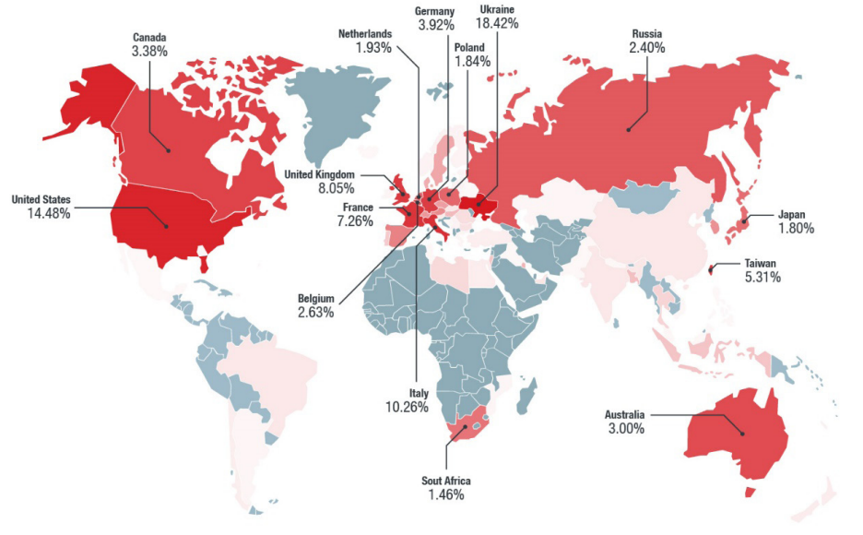
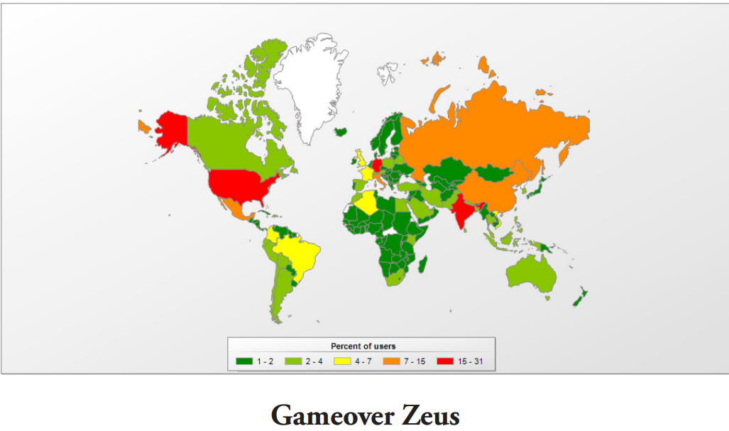
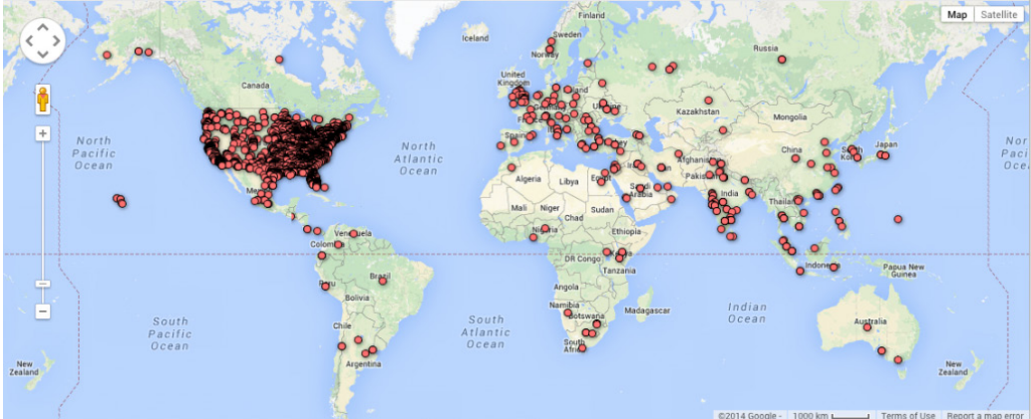
problem Statement
The goal is to recognize botnet behaviors to prevent unauthorized access, data theft, and distributed denial-of-service (DDoS) assaults using machine learning approaches.
Train AI models on enormous datasets of network traffic to learn the differentiating characteristics of botnet behavior and identify it from benign traffic.
The problem involves correctly identifying botnets while avoiding false negatives, as well as keeping up with botnet creators' evolving techniques.
VPN filter
Gameover Zeus
Mirai

Slide 5
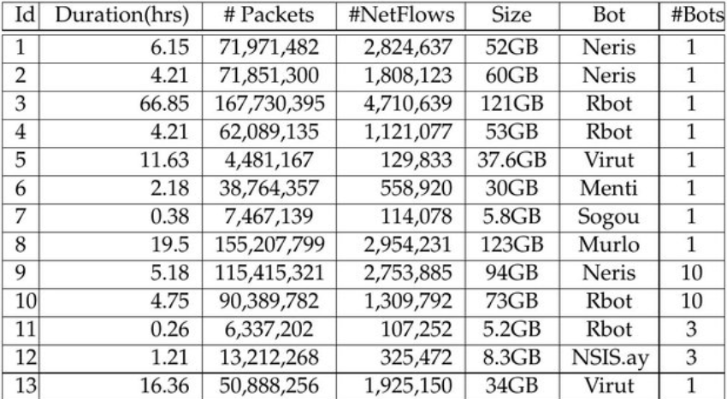
Dataset
Source: CTU University, Czech Republic (Sponsor: Dr. Ernest Smiley)
Large capture of real botnet traffic mixed with normal traffic and background traffic
7 different types of bots
Captured over 13 different session
The complete dataset is not available publicly due to privacy concern
The subset of data publicly available is 75 Gigabytes in size

Slide 6
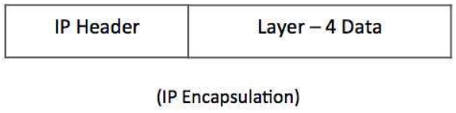
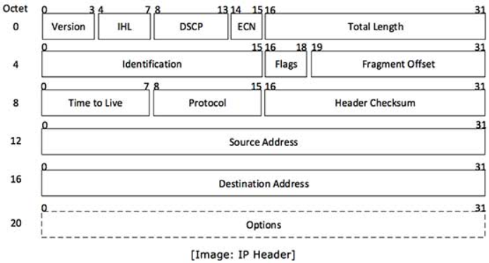
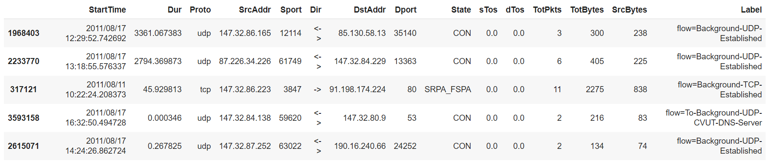
Dataset
15 features
~20 million rows

Slide 7
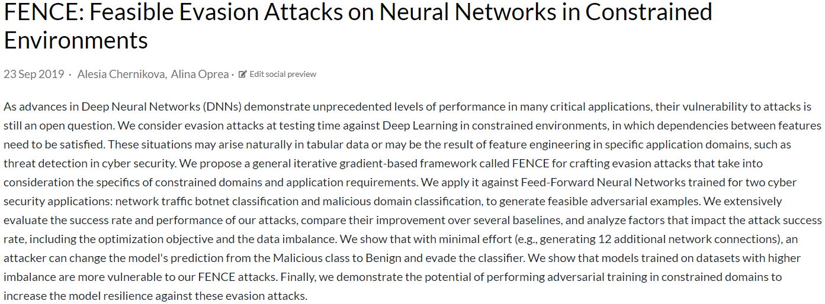
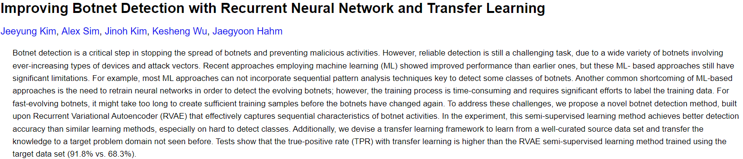
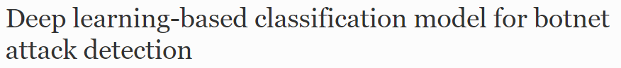
Related Work

Slide 8
Methodology
Preprocessing
Model Architecture
Training
Evaluation

Slide 9
Preprocessing
Target Encoding: Target label contains 52 unique values; these values were converted to binary values:
Normal & Background traffic: 0
Botnet traffic: 1
Train test split – 80% train and 20% test split => No data leakage

Slide 10
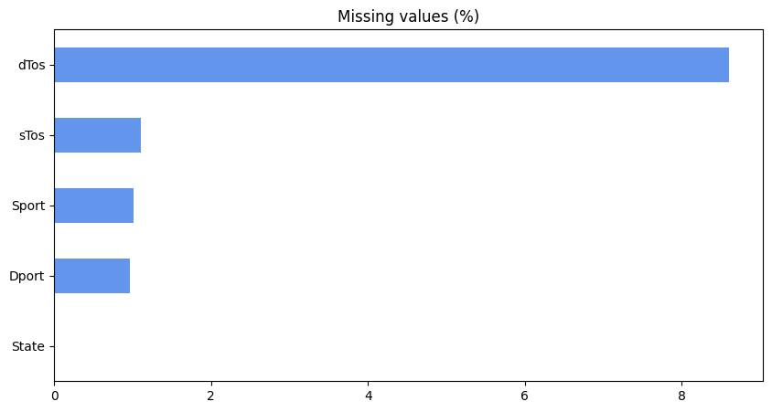
Preprocessing
Data Cleaning:
Find & replace missing values with the most popular values (mode)
Perform separately on training set and test set

Slide 11
Preprocessing
Feature Engineering:
'SrcAddr' and 'DstAddr’: Convert IP Address, IPv4 most common – drop others
'Sport' and 'Dport': Convert to numerical values
'Dir': Fix wrong values
‘Proto’ and ‘Dir’: Convert using One Hot Encoding
Perform separately on training set and test set
Linear Correlation Matrix: drop high-correlated features

Slide 12
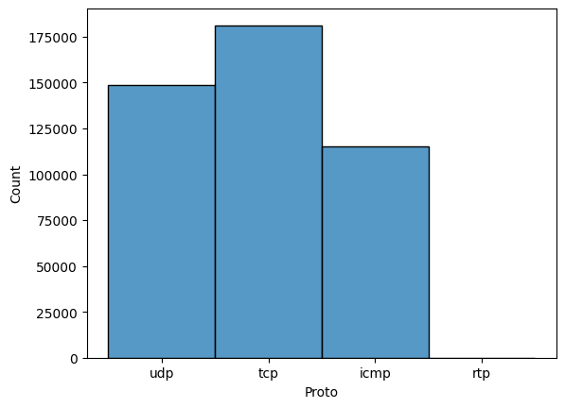
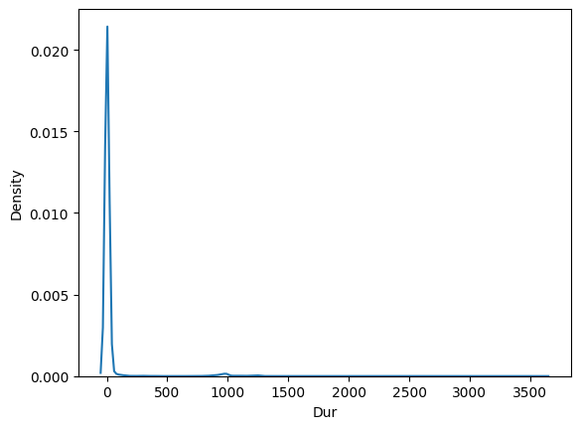
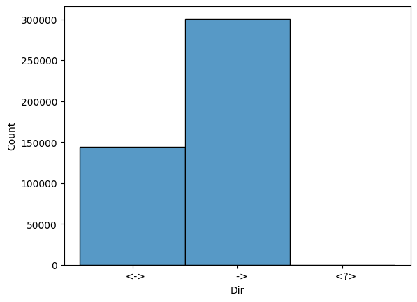
Preprocessing
Data Visualization (botnet):

Slide 13
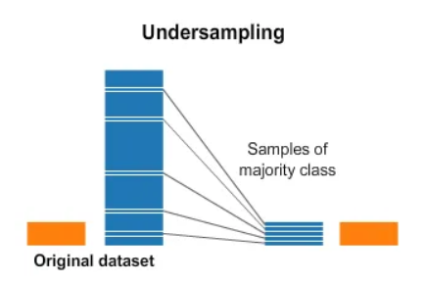
Preprocessing
Features-Target Split
Imbalanced data: Under sampling techniques
Feature Scaling: Robust Scaler (robust to outliers)
Perform separately on training set and test set
Final training set: ~700,000 rows, 23 features

Slide 14
Model building & Evaluation
Train & Test on few datasets of 1 botnet (Rbot), then Test again on a completely new dataset of the same botnet (Rbot)
Train & Test on 13 datasets of 7 botnets
Train & Test on 12 datasets of 6 botnets, then Test again on a new unknown botnet

Slide 15
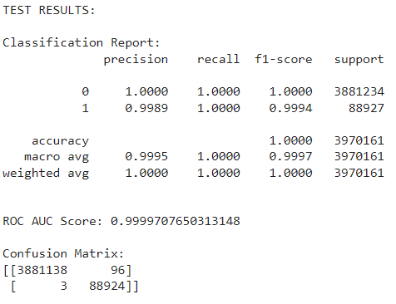
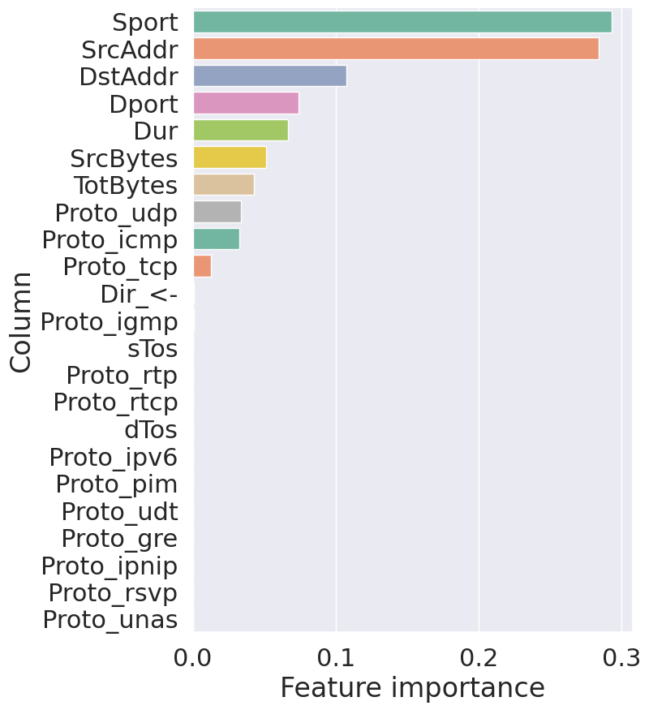
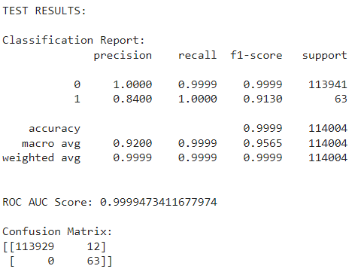
Random Forest
Mixture:
Unknown botnet:

Slide 16
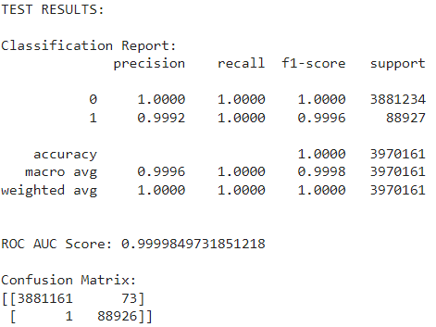
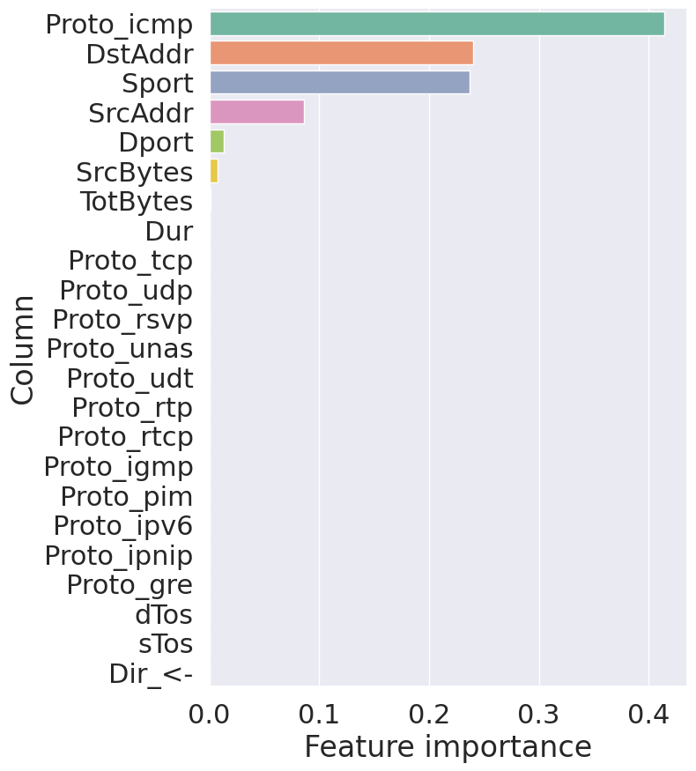
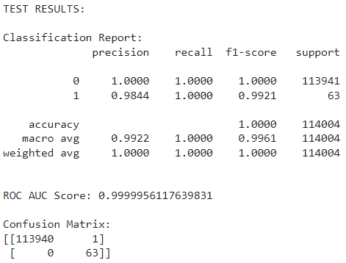
XGBoost
Mixtture:
Unknown botnet:

Slide 17
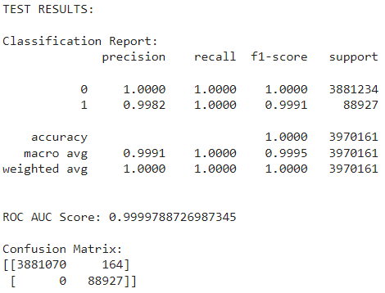
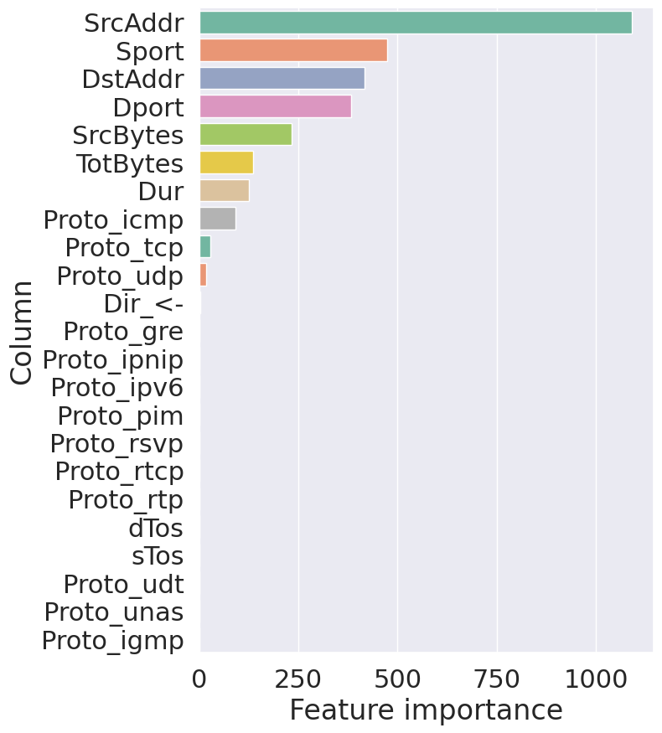
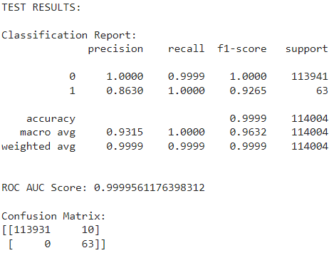
Light GBM
Mixture:
Unknown botnet:

Slide 18
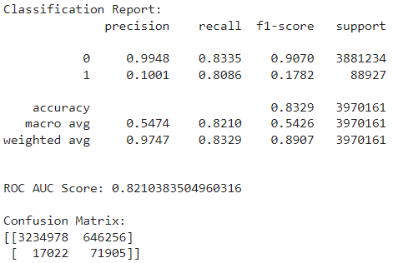
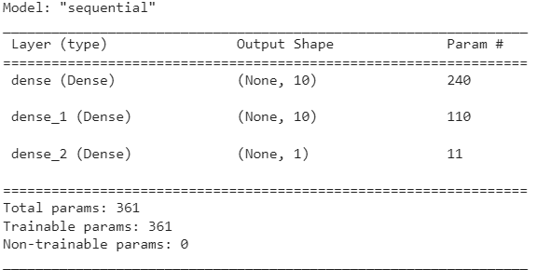
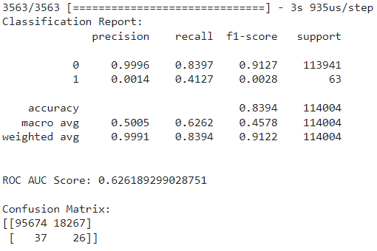
Neural network
Mixture:
Unknown botnet:

Slide 19
Conclusion and future work
We build 4 models to predict the botnet (Random Forest, XGBoost, LightGBM, Neural Network). The conventional machine learning model had similar accuracy, but LightGBM had smallest false negative rate on training and test set.
Further, the features used by for prediction, Address, Port, Duration and packet size are practical and can monitored in a network
Neural Networks we worked with was not able to achieve accuracy higher than 89%
Future works: Create a pipeline and deploy the model in production, verify false positives and retrain models

Slide 20
References
Botnets. (2016, February 17). ENISA. https://www.enisa.europa.eu/topics/incident-response/glossary/botnets
Bederna, Z., & Szádeczky, T. (2021). Effects of botnets – a human-organisational approach. Security and Defence Quarterly, 35(3), 25–44. https://doi.org/10.35467/sdq/138588
Taking down botnets. (2014, July 15). Federal Bureau of Investigation. https://www.fbi.gov/news/testimony/taking-down-botnets
IPv4 - Packet Structure. (n.d.). Tutorialspoint.com. Retrieved March 29, 2023, from https://www.tutorialspoint.com/ipv4/ipv4_packet_structure.htm
García, S., Grill, M., Stiborek, J., & Zunino, A. (2014). An empirical comparison of botnet detection methods. Computers & Security, 45, 100–123. https://doi.org/10.1016/j.cose.2014.05.011

